Slide 1
PERSONAL ASSISTANCE FOR SENIORS WHO ARE SELF RELIANT

Slide 2
Team ID: PNT2022TMID21391
Reg. No | IBM Reg. No | Name
19D058 | 917719D058 | Nisha C (Team Lead)
19D022 | 917719D022 | Fathima D
19D028 | 917719D028 | Harni V
19D132 | 917719D132 | Sangeetha M

Slide 3
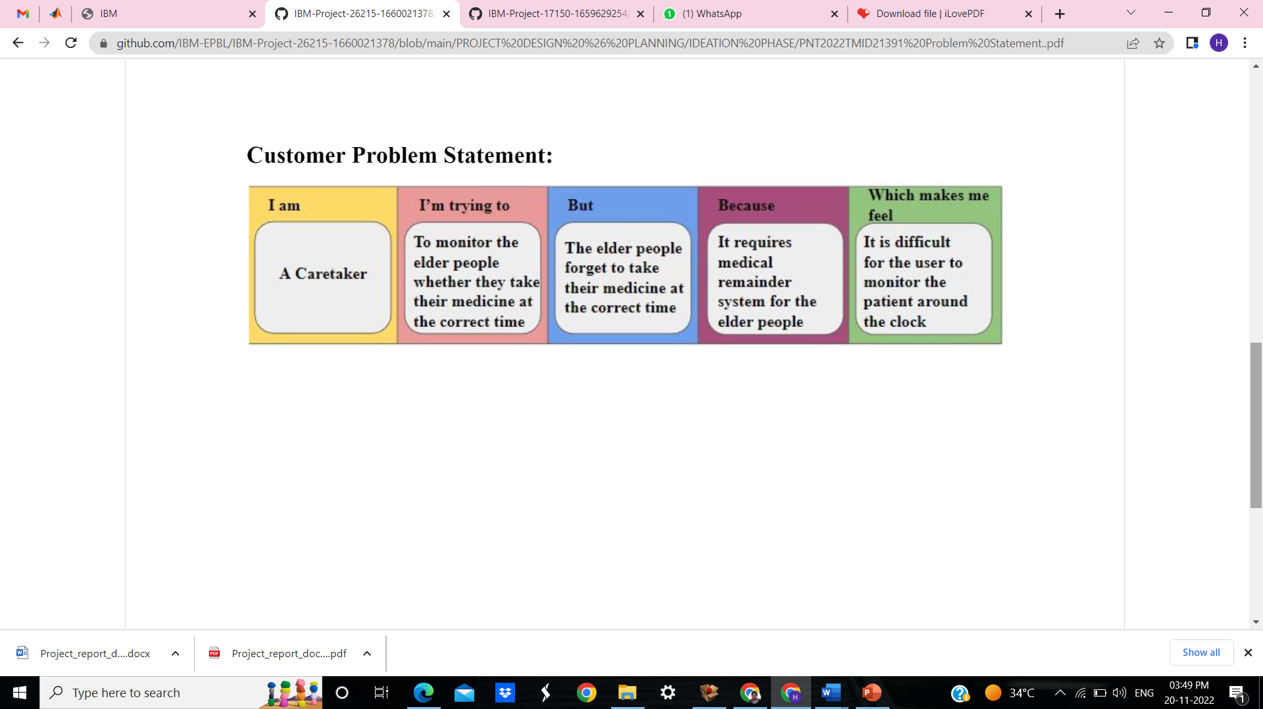
Problem Statement
Our problem statement is to remind the elderly persons to take their medicines on correct time.

Slide 4
Proposed Solution
S. No | Parameter | Description
1 | Problem Statement (Problem to be solved) | Sometimes elderly people forget to take medicines at correct time ,to avoid this medicine remainder system is developed.
2 | Idea / Solution description | In order to monitor elders we proposed medicine reminder system. An app is built for the user (caretaker) which enables them to set the desired time and medicine. These details will be stored in the Cloud DB. If the medicine time arrives the web application will send the medicine name to the IoT Device through the IoT platform. The device will receive the medicine name and notify the user with voice commands.

Slide 5
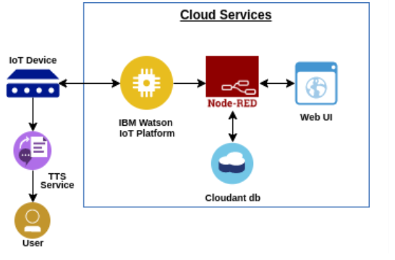
3 | Novelty / Uniqueness | Digital Voice Command technology Notification System.
4 | Social Impact / Customer Satisfaction | This will be helpful for the caretakers/doctors for monitoring the health conditions of elders and also this creates positive impact on seniors health.
5 | Business Model (Revenue Model)
6 | Scalability of the Solution | In future increase the number of users, Maintains best possible user experience. Helps the elders to take medicines regularly And also helps to refill the medicines.

Slide 6
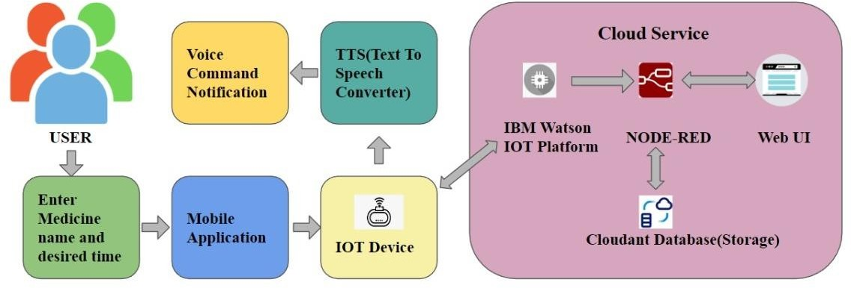
Technical Architecture

Slide 7
Working Demo of the Project
https://drive.google.com/file/d/1VeqFoMyc_XmuVv9yxYQDNWSN4Ng7QkBH/view?usp=share_link

Slide 8
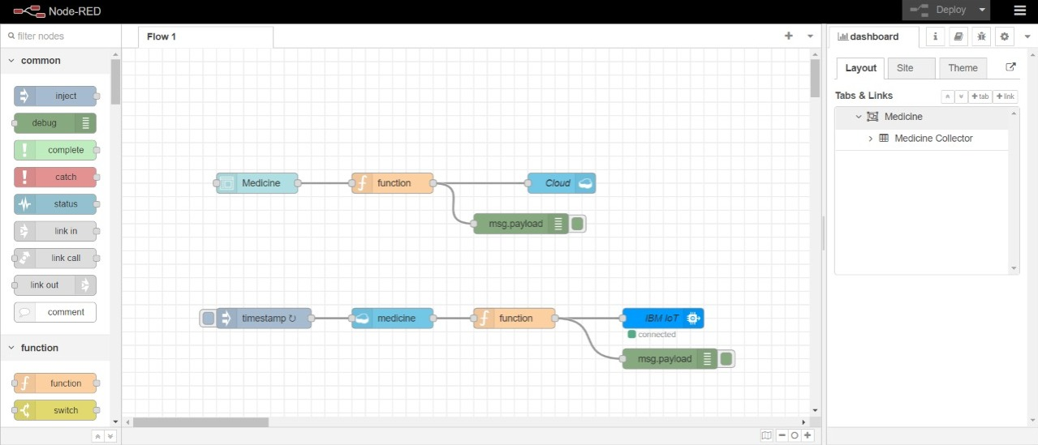
Results

Slide 9
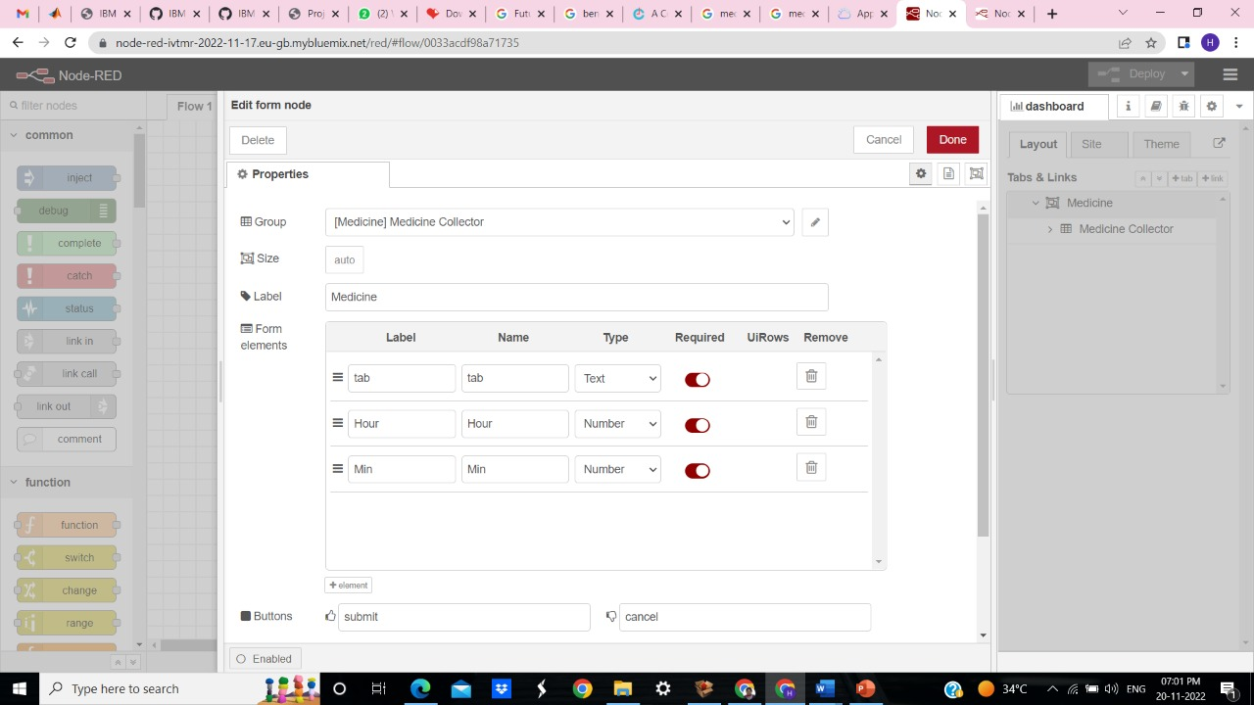
Medicine name and time can be entered to get alert

Slide 10
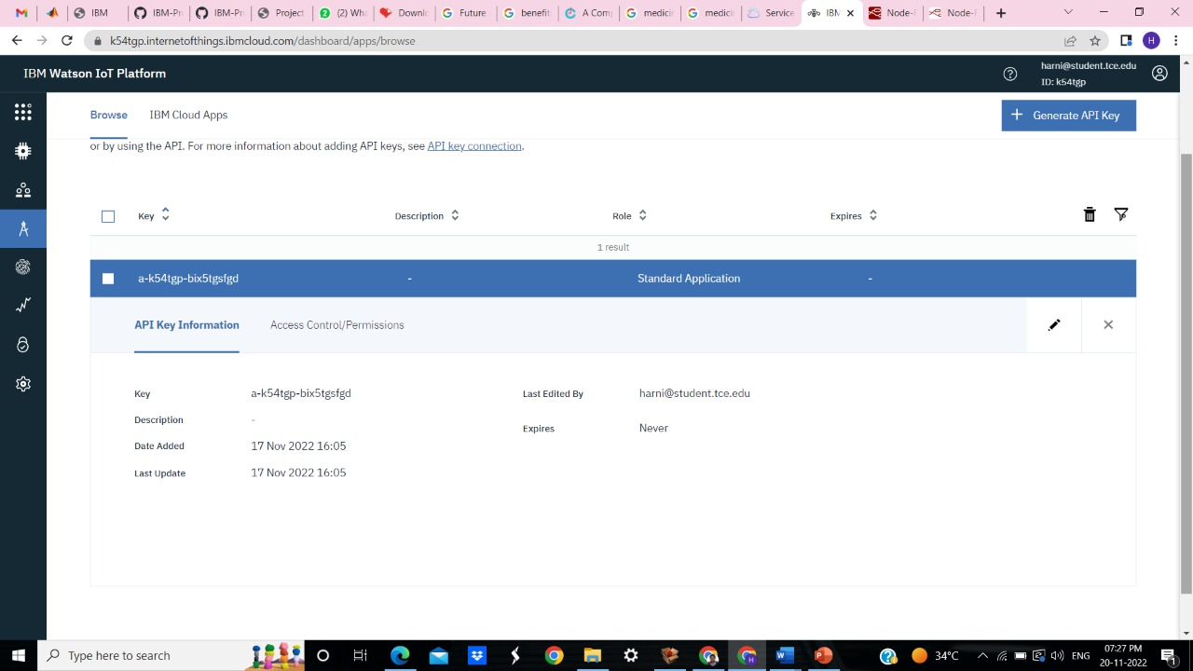

Slide 11
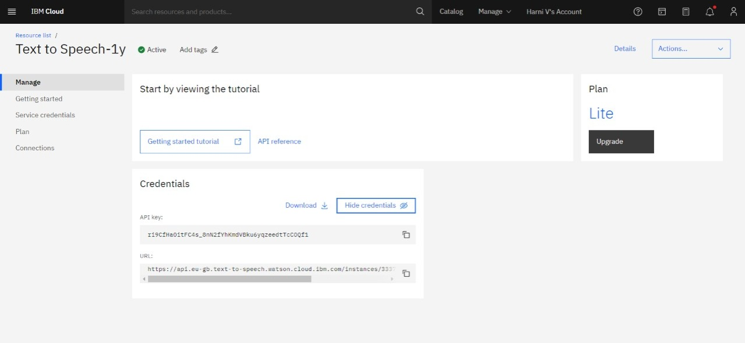

Slide 12
Feature Scope
Health information:
The application helps family members to keep track of medicines.
Alert message:
If medicines are out of stock it gives alert message.
Order nearby:
We can order medicines in nearby pharmacy.
Users:
Single point to multi point user.

Slide 13
Thank you

